Slide 1

Different between culture
China and Japan

Slide 2
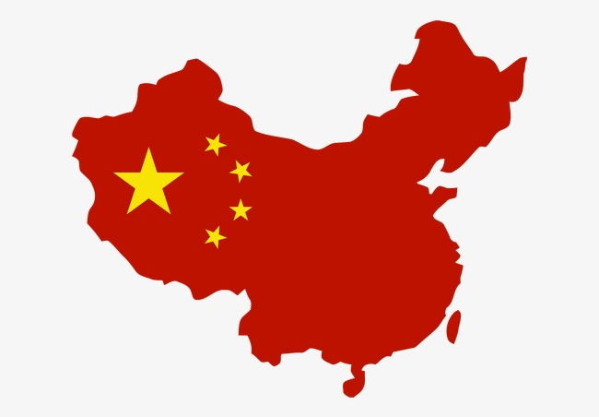
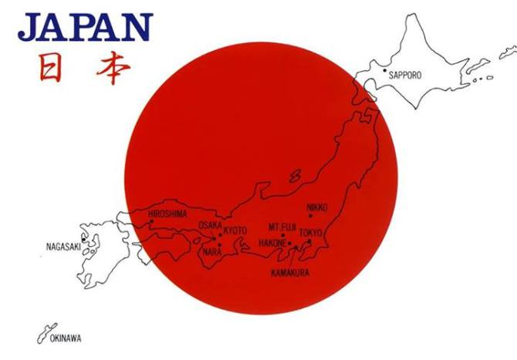
1. Language:
chinese
japanese

Slide 3
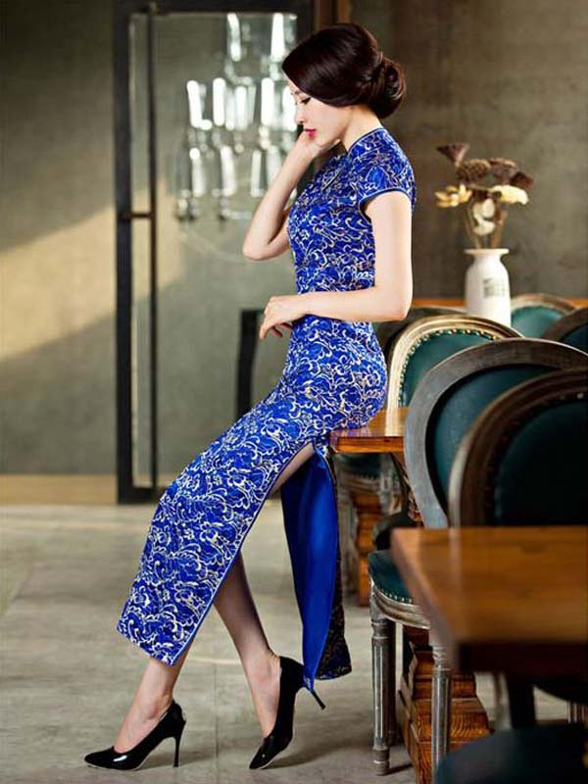
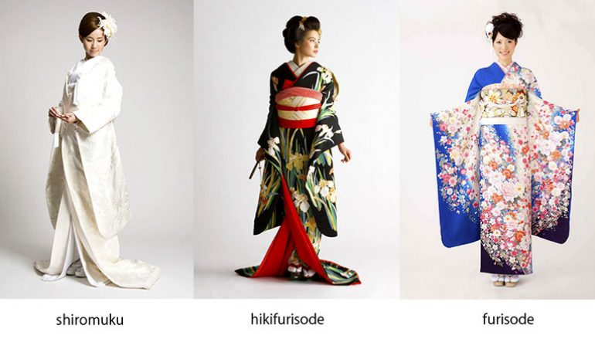
2. Traditional costume:
cheongsam
kimono

Slide 4
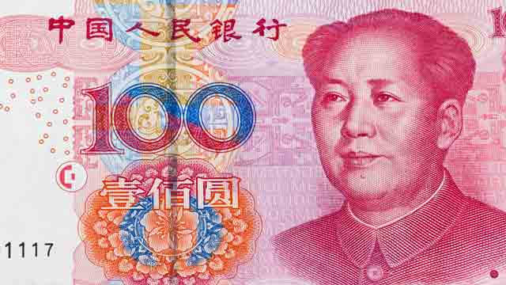
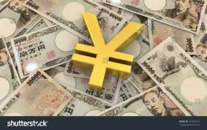
3. Currency:
Renminbi (CNY)
Yen

Slide 5
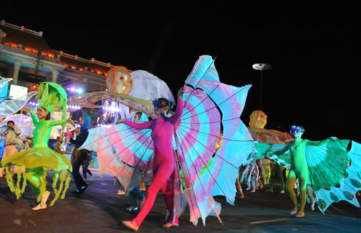
4. Festival:

Slide 6
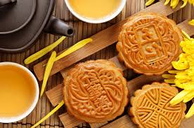
Festival in China: Lunar New Year. Moon Festival. Lantern Festival. Grave-visiting Festival. Dragon Boat Festival.

Slide 7
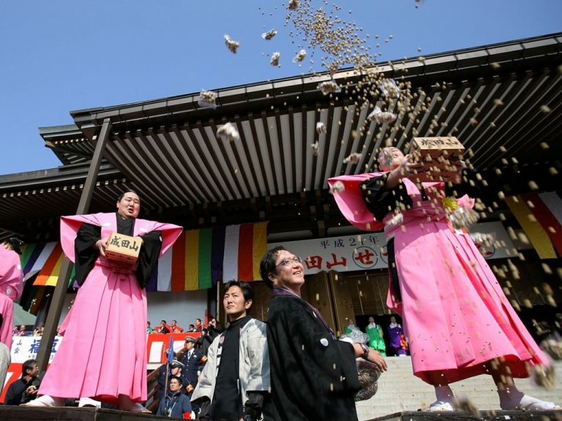
Festival in Japan: Cherry Blossom Festival. Japan New Year (Shogatsu). The Bean-Throwing Festival. Golden Week.

Slide 8
Thanks for listening

